Slide 1
DATA VISUALISATION CA1 HOUSING RESALE (INDIV)
Done by: Randy See Meng Teck (p2021669)

Slide 2
OBJECTIVES
#01: Find the trend of HDB resale prices
#02: Find out what affects HDB resale prices
Use quantitative and predictive analysis to understand the trend to get best value for resale flats and be future-proof
Unfold the factors that affects resale prices to cut down on unnecessary costs for resale flats

Slide 3
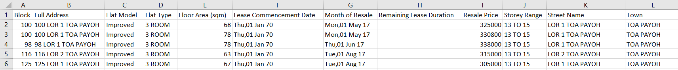
EXPLAINING DATASET
Number of rows: 141635
Number of columns: 12
Size of dataset: 16.6MB
<Block> refers to the block number of the unit
<Storey Range> refers to the floor level of the unit
<Street Name> refers to the closest street adjacent the unit
<Town> refers to the town the unit is located within
<Full Address> in the format <Block> + <Street Name>
<Flat Model> refers to the design model of unit rooms
<Flat Type> refers to the dimensions of room in the unit
<Floor Area (sqm)> refers to the size measure of the unit
<Lease Commencement Date> refers to when the unit’s 99-year lease began when the leased was sold to the first owner
<Month of Resale> refers to the date of when the unit was resold
<Remaining Lease Duration> refers to the number of years left before the unit’s lease expires. It is 99 years after <Lease Commencement Date>
<Resale Price> refers to the price the flat was sold at in SGD(S$)

Slide 4
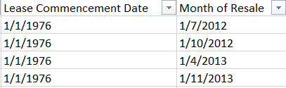
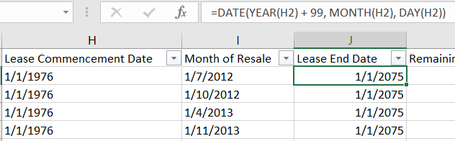
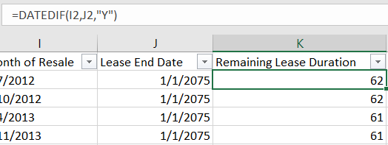
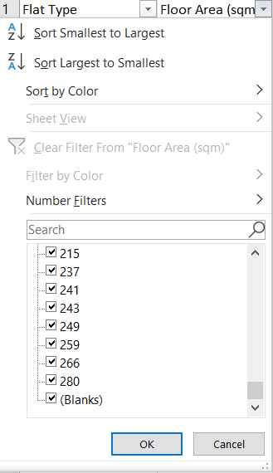
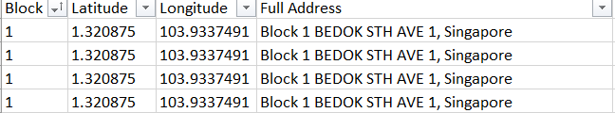
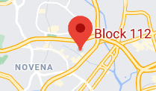
CLEANSING DATASET DATE
Clean DD/MM/YYYY format Get <Lease End Date> and <Remaining Lease Duration>
Remove null in <Floor Area (sqm)> Geocode using Python
Clean <Town> locations

Slide 5
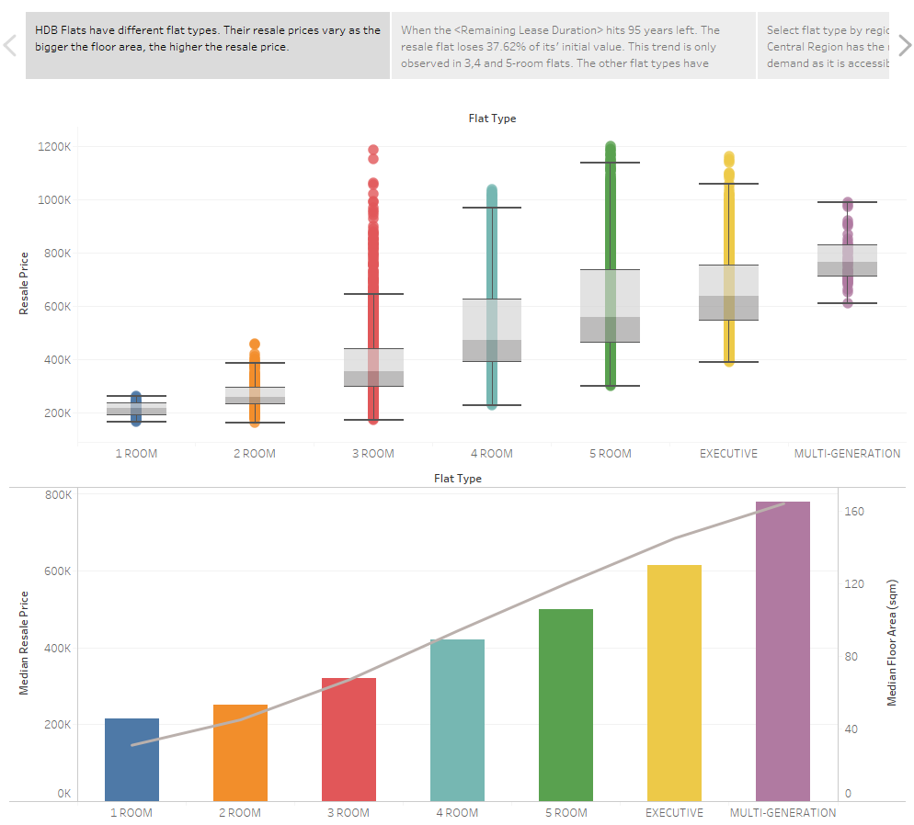
INSIGHTS
Resale flat prices are linearly correlated to the floor area.
Notes:
The top chart shows the resale price distribution based on flat type. We can observe that different flat types have different prices and 3-room flat has a lot of outliers.
The bottom chart shows the median resale price and median floor area based on flat type. We can see that the median floor area trend line is linearly correlated to the median resale price of different flat types.
We can observe that different flat types have different prices. Investigating, we find that the floor area and resale price are tied together linearly.
Similarly, the better the flat type, the bigger the floor area will be.

Slide 6
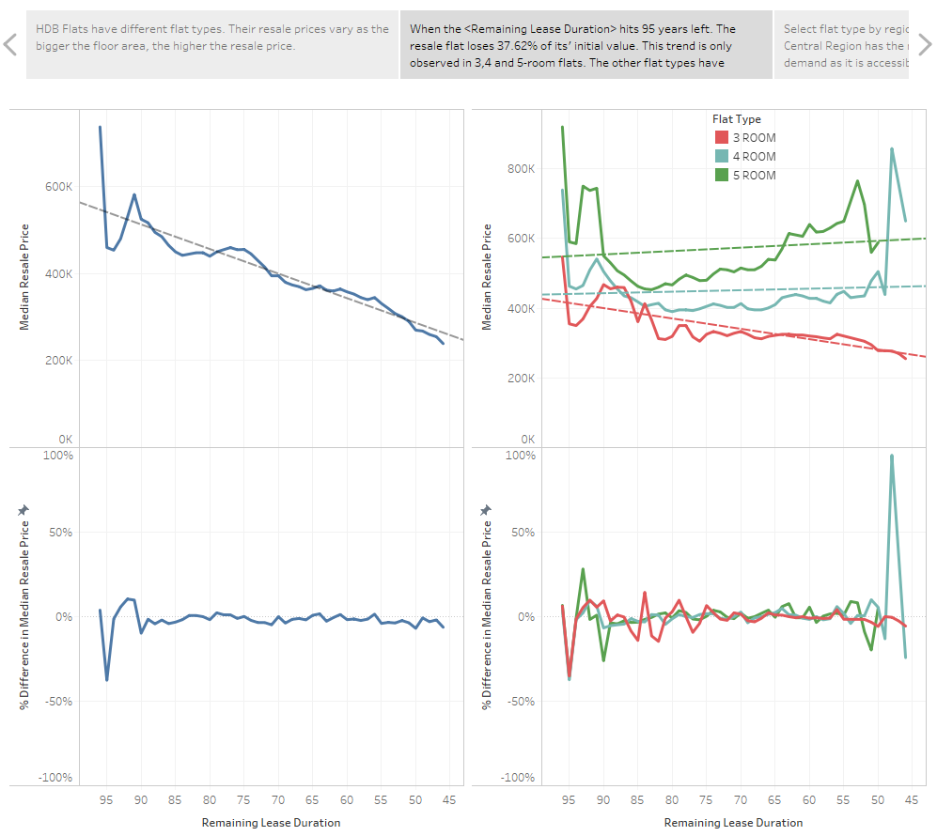
INSIGHTS
At the 95-year mark, resale flat prices drastically drop by ~37% of its’ original value. And does not drop drastically anymore thereafter This can be observed in 3, 4 and 5-room flats.
RECOMMENDATION
Buy resale flats when they
have 95 years left on it’s
remaining lease duration.
Notes:
The top left chart shows the trend of median resale price as the remaining lease duration decreases.
We bottom left chart shows the trend in % difference from the previous value.
The top right chart shows the trend only applies for 3,4 and 5-room flats as the other flat types have insufficient data to prove it.
The bottom right shows the trend in % difference from the previous value.
We can observe that although the median resale price is in a linear trend, there is a sharp spike at 95-94 years left on remaining lease duration.
This is because HDB owners can only sell their flats after the minimum lease period of 5 years.
This means that the HDB owners want to sell their flats in a hurry such that they are willing to sell at a lower price than market value.
The resale flats sold before the 95-years remaining lease duration are for special conditions whereby the owner of the flat is deceased etc.

Slide 7
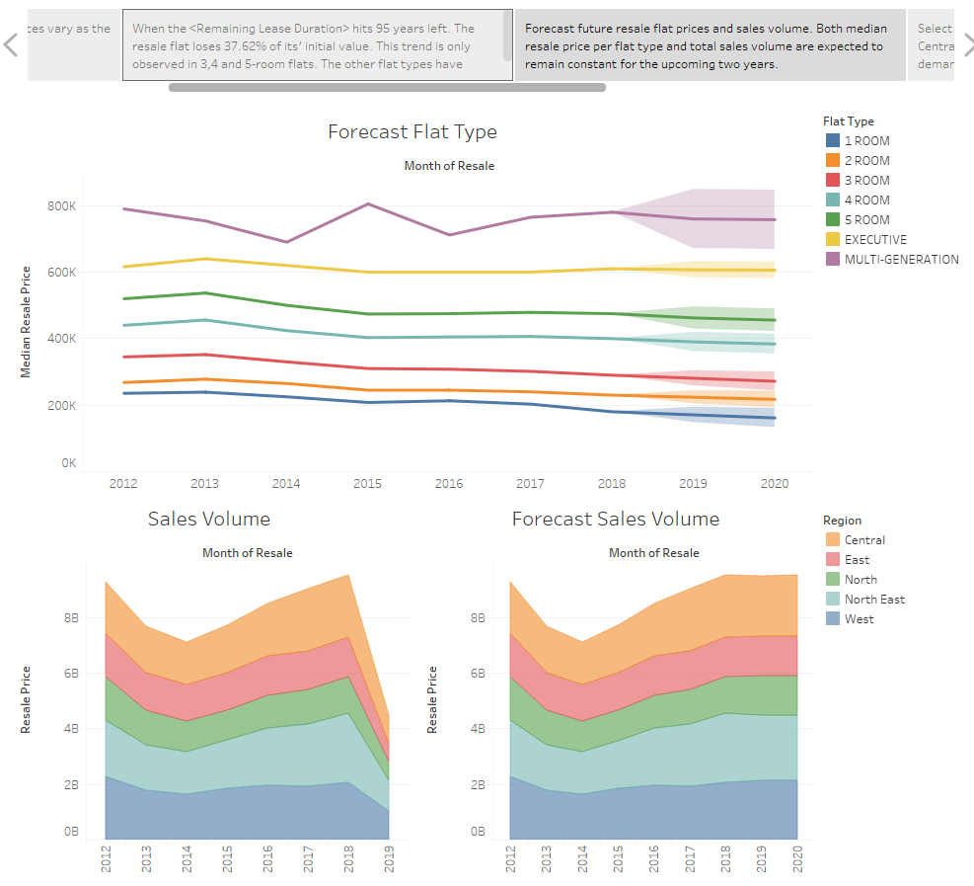
INSIGHTS
In the upcoming 2 years, the value of resale flats and total sales volume will remain constant.
RECOMMENDATION
2019 is not a good year to
invest in real estate as the
sales volume and price is
predicted to remain normal.
Notes:
The top chart shows the forecast of median resale price for different flat types for the upcoming 2 years.
The bottom left chart shows the current sales volume for different regions
The bottom right chart shows the forecast of future sales volume for different regions for the upcoming 2 years.
We can observe that in the upcoming 2 years, the HDB resale flat market will not be growing. Thus, we should wait
and observe for resale price trends to occur.

Slide 8
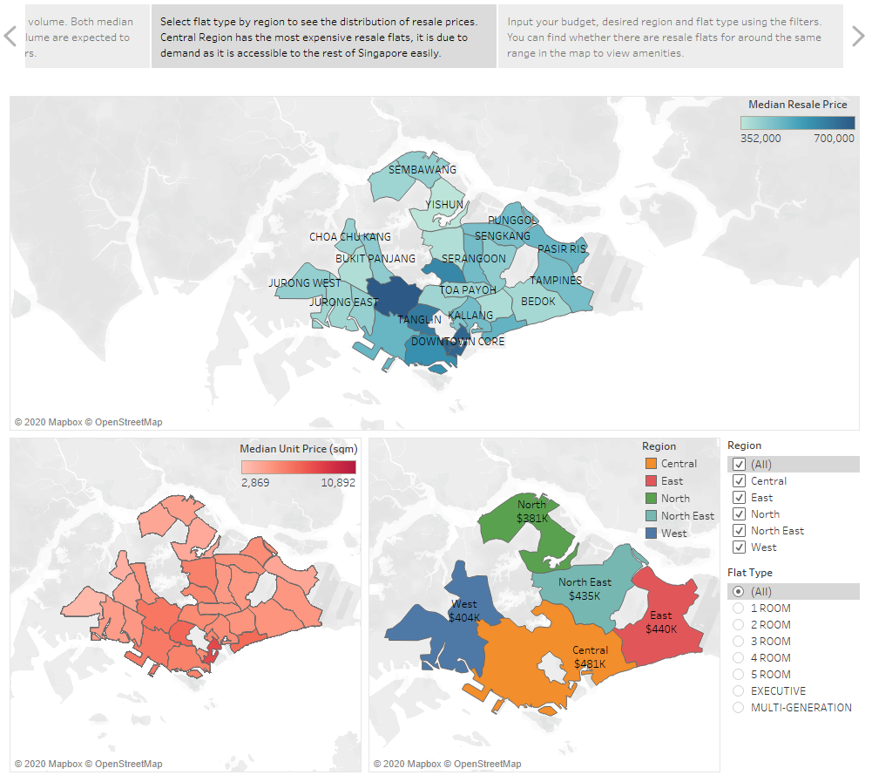
INSIGHTS
The Central Region is the most expensive region to buy a resale HDB flat.
RECOMMENDATION
If you are on a tight budget, you should NOT buy a flat in the Central Region as it costs significantly more as the other regions.
Notes:
The top chart shows the median resale price per town for all flat types.
The bottom left chart shows the median unit price per town for all flat types.
*Median unit price (sqm) is calculated by <Median Resale Price> / <Floor Area (sqm)>
The bottom right chart shows the median resale price per region for all flat types
We can observe that the prices of resale HDB flats are concentrated at the center of Singapore.
This is because of the huge demand to live in the Central as it is easily accessible to all parts of Singapore and it is
Considered the “city area” of Singapore.

Slide 9
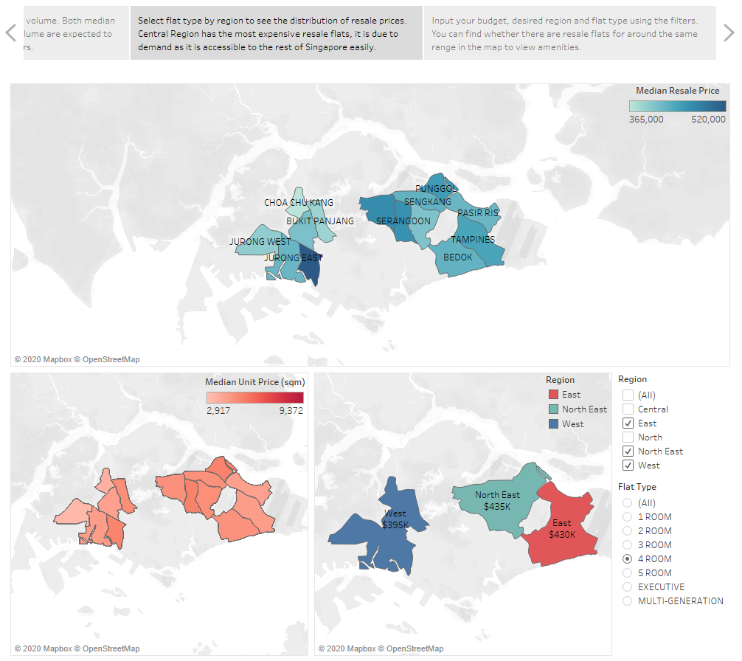
INSIGHTS
Between the East, North East, and West, the cheapest 4-room flat is in the West side, specifically the town Choa Chu Kang.
RECOMMENDATION
If you are on a tight budget for a 4-room flat, you should buy a flat at Choa Chu Kang
Notes:
The top chart shows the median resale price per town for 4-room flats.
The bottom left chart shows the median unit price per town for 4-room flats.
*Median unit price (sqm) is calculated by <Median Resale Price> / <Floor Area (sqm)>
The bottom right chart shows the median resale price per region for 4-room flats.
Using the filter functions,
We can find the flats closest to the Central Region of Singapore if we are on a tight budget.

Slide 10
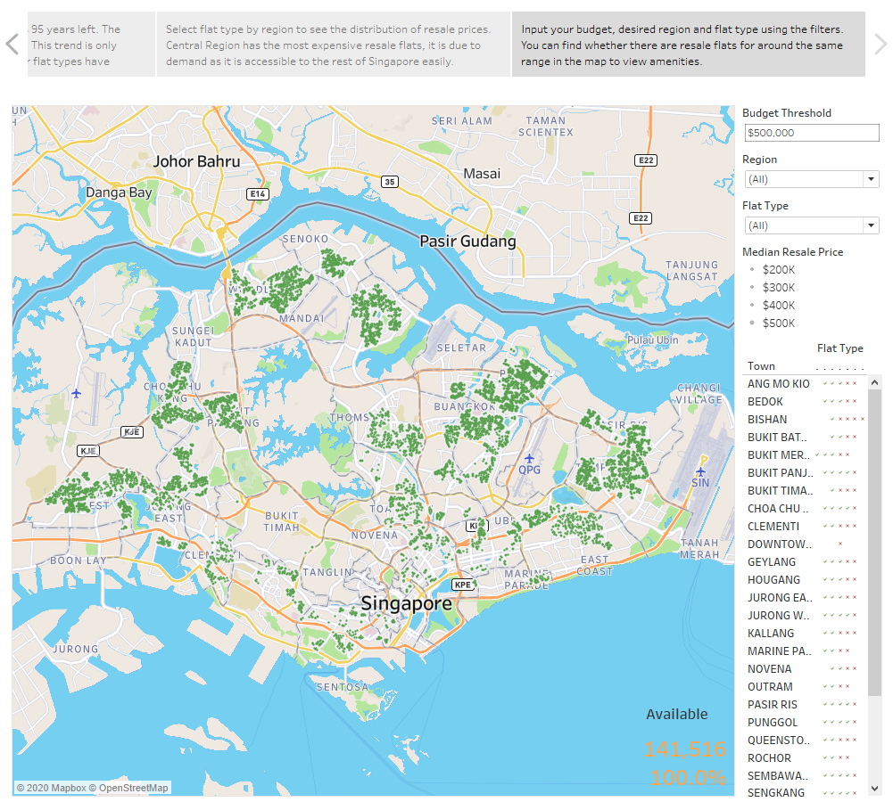
INSIGHTS
There have been 141,516 resale units sold in Singapore so far.
Notes:
The map shows you historical resale flats that have been sold based on your budget threshold.
The bottom right shows you the availability of the flats based on your budget threshold.
Available flats are imprinted on the bottom right of the map.

Slide 11
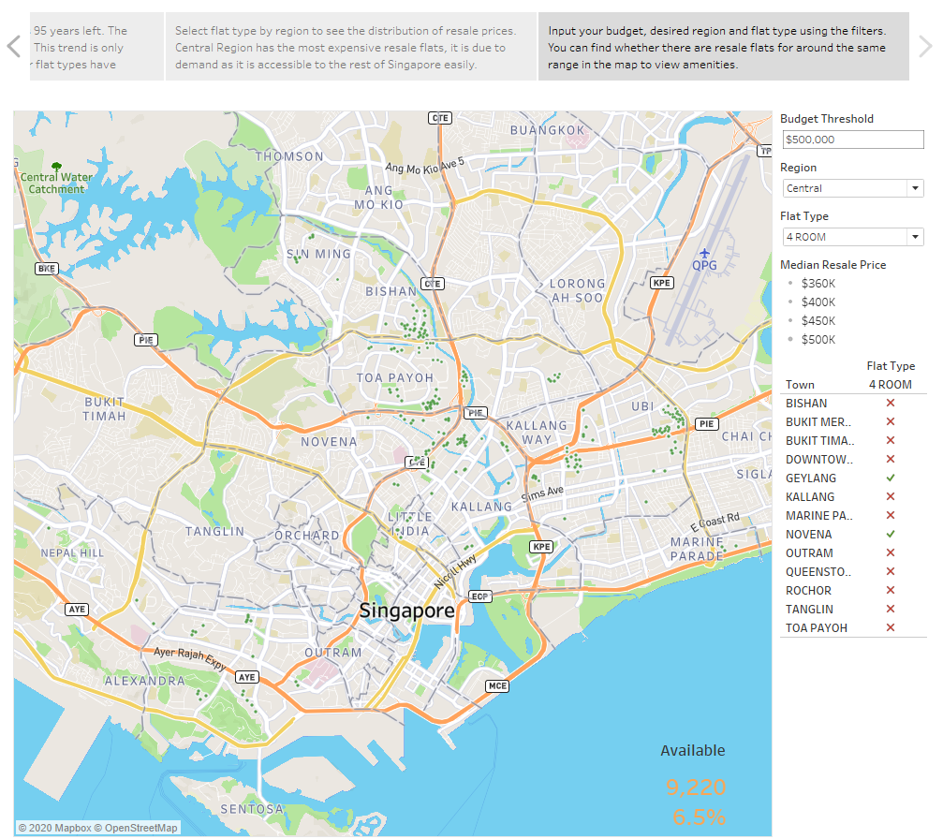
INSIGHTS
Central Region, 4-room flats, below the budget of $500k accounts for 9,220 (6.5%) of resale flats in Singapore.
RECOMMENDATION
You can look for amenities around common resale flats so that you can cut down on unnecessary costs paid on unneeded amenities
Notes:
With a budget of 500k, if you want to live in a 4-room flat at the Central Region,
you only have the options of living in Geylang and Novena.
Use the street map to view amenities that you would like nearby the flats.

Slide 12
LIBRARIES REFERRED TO
Google Maps Platform | Google Developers
onemap-api/HDB data extract.py at master · mylee16/onemap-api · GitHub
onemap-api/extracting planning area from one-map-api.ipynb at master · mylee16/onemap-api · GitHub
WHAT I HAVE LEARNT
I have learnt how to geocode using Python
I have learnt that planning plays a huge part in data analysis
I have learnt that data visualisation is important in real world context

Slide 13
THANKS
Please keep this slide for attribution

